Slide 1
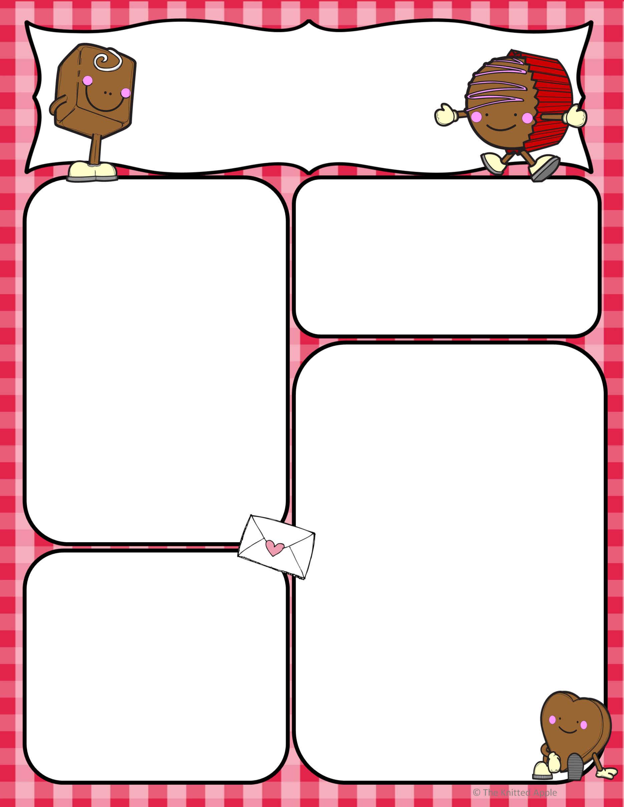
FEBRUARY 2021 NEWSLETTER
UPPER MIRAMICHI ELEMENTARY SCHOOL
Pink Shirt Day Order Forms are Due back
Wednesday, Feb. 3rd. There was a misprint on the Forms that came to us preprinted that said the 6th. Pink Shirt Day is Feb. 24 in recognition of Anti-Bullying
FEBRUARY 15TH
^{POINTS OF INTEREST:}
UMES Staff plan to host Winter Carnival Events within the respective bubbles the week of
^{Feb. 22nd – 26th}
UMES Staff would like to Thank Parents for your support during this unique covid year
Gr. 1—Feb. 1st Mrs. Clowater will be returning from her maternity leave. Mrs. Cornell is going to another school and we wish her all the best
School Survey Results completed in early December for Students Gr. K-5 indicate:
^{95.5% feel safe at school}
^{97.7% like coming to school}
MASKS
Students need to have 2 clean masks and should also have extra mittens for outside
MORNING DROP OFF
With the winter weather upon us and busses sometimes being a little later than normal, we would ask that if you are dropping off
Your child to arrive between 8:00-8:05
APRIL
April 2 & 5: Easter Weekend
April 14: Parent Teacher/PL
April 22: Earth Day
FEBRUARY
Feb. 8 – 12: Staff Appreciation Week
MARCH
March 1 – 5: March Break
March 19: PL Day (No School)
March 31: Report Cards Go Home

